Slide 1
Post Machine

Slide 2
POST Machine
A Post machine denoted by PM is a collection of five things
  The alphabet Σ plus the special symbol #. We generally use Σ = { a, b}.
  A linear storage location (a place where a string of symbols is kept called the STORE or QUEUE, which initially contains the input string.
    This location can be read by which we mean the leftmost character can be removed for inspection.
    The STORE can also be added to, which means a new character can be concatenated onto the right of whatever is there already.
    We allow for the possibility that characters not in Σ can be used in the STORE, characters from an alphabet Γ called the store alphabet.

Slide 3
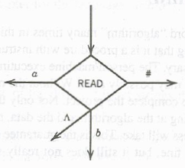
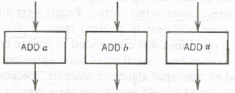
POST Machine Contd.
  READ states, for example,
  PMs are deterministic, so no two edges from the READ
  have the same
  ADD states:

Slide 4
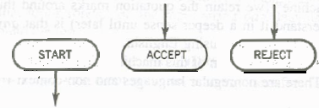
POST Machine Contd.
  A START state (un-enterable) and some halt states called ACCEPT and REJECT

Slide 5
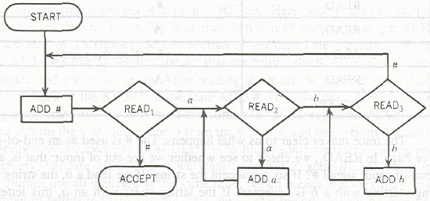
Example
Consider the following PM and guess the language?

Slide 6
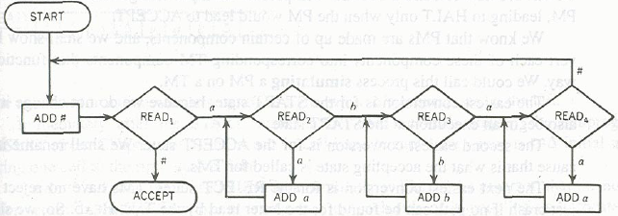
Another POST Machine

Slide 7
Simulating a PM on TM
Theorem:
A language accepted by PM can also be accepted by TM.
Proof:
We can simulate a PM over TM. PM consists of many components.
By simulating we means, we will show how to convert each of these components into corresponding TM components that function the same way.

Slide 8
Simulating PM on TM
Start state of PM is same as TM’s start state. So no conversion needed.
Accept state of PM will be renamed as HALT state of TM.
REJECT state of PM will be converted by deleting the REJECT states and all the edges coming into REJECT states.
Now how to keep track of PM store contents when simulating over TM tape?

Slide 9
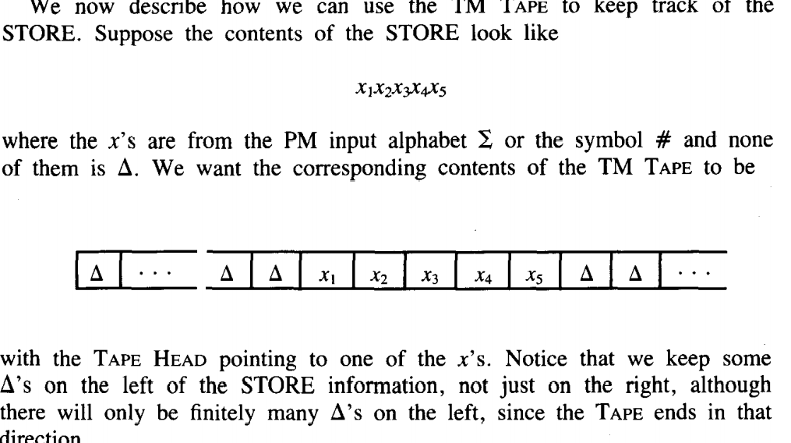
PM Store on TM
Suppose the contents of STORE are
xxxxx
 |  | x | x | x | x | x

Slide 10

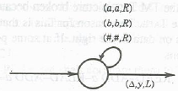
HOW to simulate STORE over TAPE?
Can be simulated by

Slide 11

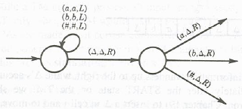
Can be simulated by

Slide 12
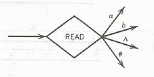
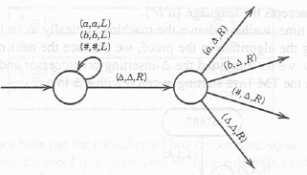
If PM reads empty STORE
Then it becomes

Slide 13
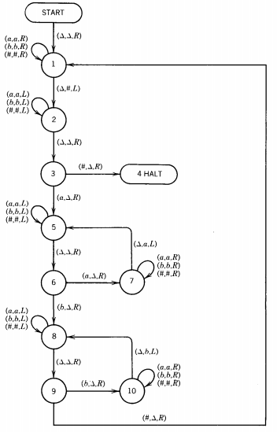
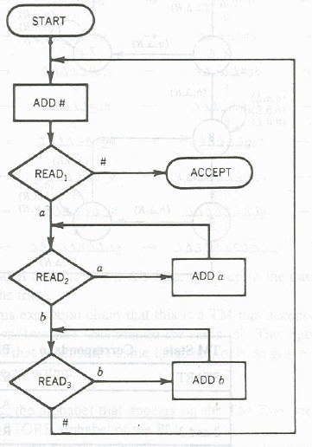

Slide 14
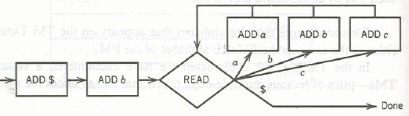
Simulating A TM ON A PM
Add Front - subprogram
There are subprograms that can enable PM to add character to the front (left end) of the string in the STORE

Slide 15
SHIFT-RIGHT CYCLICALLY.
Read Back -- subprogram
Read the character off the back (right end) of the string.
The subprogram that reads the back character from the STORE and branches accordingly be known as SHIFT-RIGHT CYCLICALLY.

Slide 16
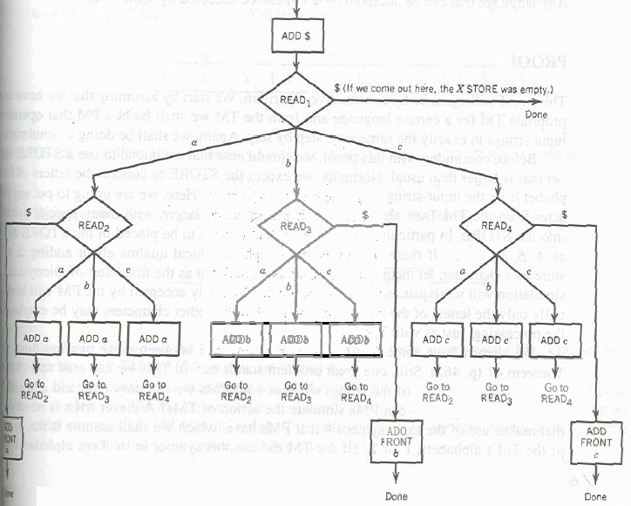

Slide 17
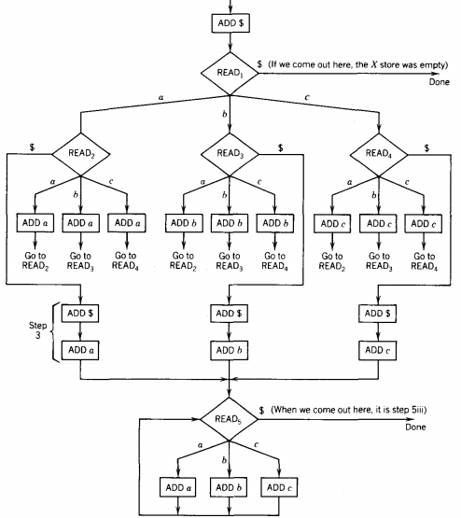


Slide 18


Slide 19
Theorem 49
A Language that can be accepted by TM can also be accepted by PM.
Proof:
Proof is left for your exercise…..

